Slide 1
The Conservation of Energy for Systems of Particles
Dr. Jacob Moore
Associate Professor of Engineering
Penn State Mont Alto

Slide 2
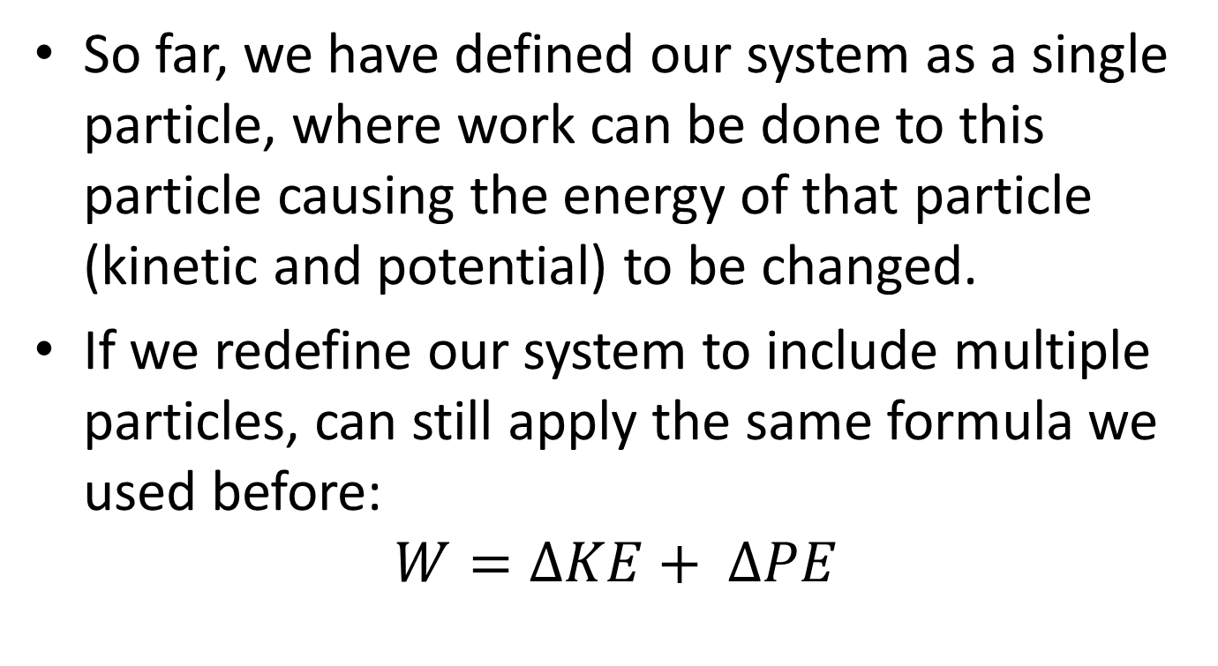
Work and Energy for Systems of Particles
So far, we have defined our system as a single particle, where work can be done to this particle causing the energy of that particle (kinetic and potential) to be changed.
If we redefine our system to include multiple particles, can still apply the same formula we used before:
$$W=∆KE+ ∆PE$$

Slide 3
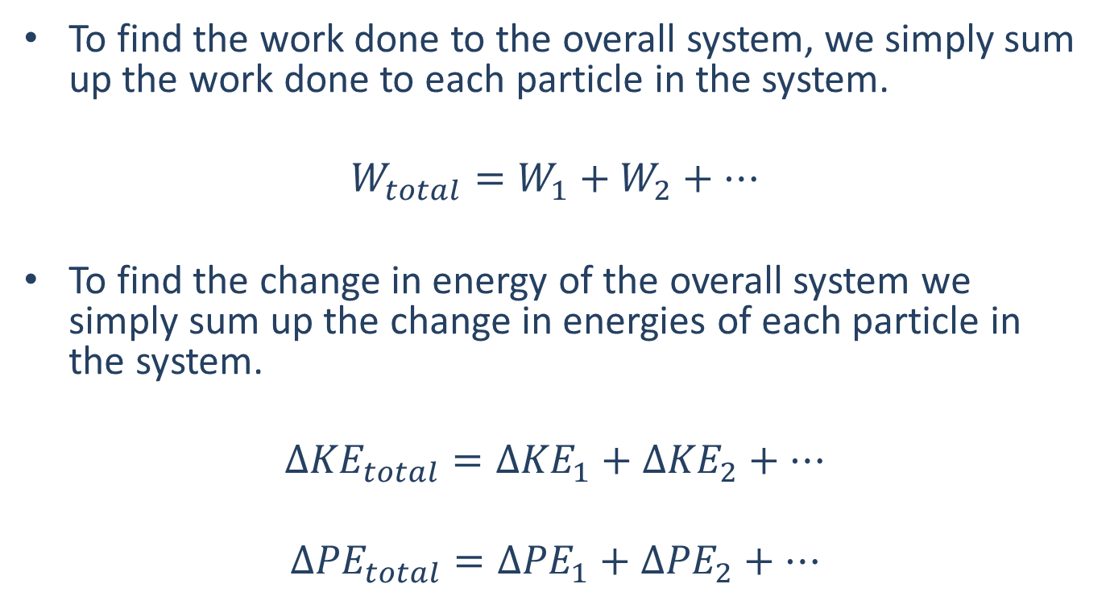
Work and Energy for Systems of Particles
To find the work done to the overall system, we simply sum up the work done to each particle in the system.
$$W_{total}=W_{1}+W_{2}+…$$
To find the change in energy of the overall system we simply sum up the change in energies of each particle in the system.
$$Δ{KE}_{total}=Δ{KE}_{1}+Δ{KE}_{2}+…$$
$$Δ{PE}_{total}=Δ{PE}_{1}+Δ{PE}_{2}+…$$

Slide 4
Internal vs. External Forces
Analyzing a system of particles (rather than analyzing each particle separately) can become advantageous, because we can ignore the work done by internal forces in our system
The reason we can ignore the work done by internal forces is because these work terms will always cancel each other out, because Newton’s Third Law ensures they will always be equal and opposite.

Slide 5
Internal vs. External Forces
An internal force is any force exerted between two bodies within the system.
An external force is any force exerted by something outside the system on one of the bodies on the system.
A
10 lbs
The tension forces in this system are internal forces
The friction force is an external force
T
F_{f}
T
B
5 lbs
5

Slide 6
Work and Energy for Systems of Particles
One potential pitfall with the work and energy method is that we will only have a single equation to work with.
In order to determine the overall relationship between the position (gravitational potential energy) and velocity (kinetic energy) we will often need to use constraint relationships established in kinematics that we discussed with dependent motion.
Using these constrain equations, along with the conservation of energy equation itself, we can often solve for the forces applied, positions, and velocities of the particles in our system.

Slide 7
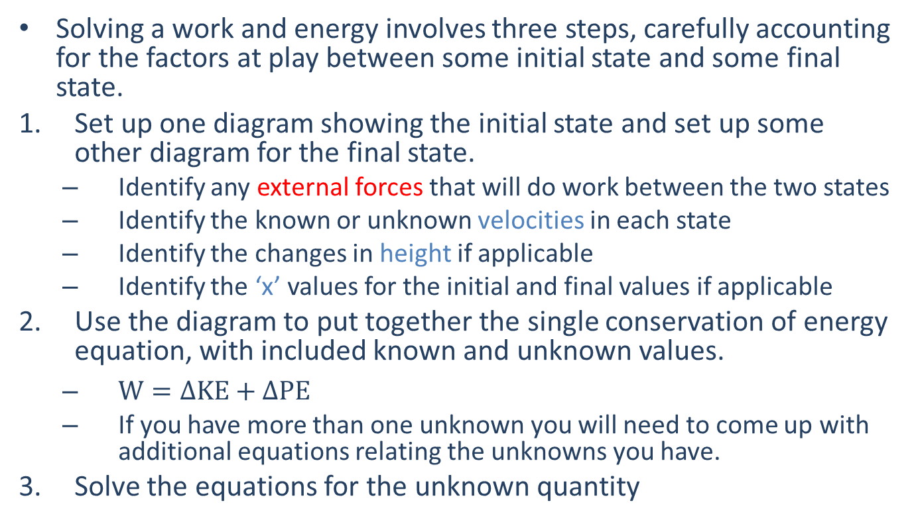
Solving a Work and Energy Problem (The Process)
Solving a work and energy involves three steps, carefully accounting for the factors at play between some initial state and some final state.
Set up one diagram showing the initial state and set up some other diagram for the final state.
Identify any external forces that will do work between the two states
Identify the known or unknown velocities in each state
Identify the changes in height if applicable
Identify the ‘x’ values for the initial and final values if applicable
Use the diagram to put together the single conservation of energy equation, with included known and unknown values.
$W=∆KE+∆PE$
If you have more than one unknown you will need to come up with additional equations relating the unknowns you have.
Solve the equations for the unknown quantity

Slide 8
Thanks for Watching
See other engineering mechanics videos and access the full tool at…

Slide 9
Work and Energy for Systems of Particles Worked Example
Two blocks are connected by a massless rope and a frictionless pulley as shown below. If the coefficient of friction between block A and the surface is .4, what is the speed of the blocks after block A has moved 6 ft?
A
10 lbs
B
5 lbs

Slide 10
Work and Energy for Systems of Participles Worked Example
The elevator shown to the right has a mass of 1500 kg and the counterweight has a mass of 500kg. At some point the cable attached to the motor snaps, causing the elevator to begin falling.
After falling 3 meters, what is the speed of the elevator?
If the emergency brake is applied at this point (3m down) exerting a constant force of 15,000 N, how much further will the elevator fall?
Roof (fixed)
Elevator
Counterweight

